Slide 1
Introduction to Machine Learning
By: Prof. Vandana Kate

Slide 2
AI: creation of intelligent machines that work or react like humans
ML: Programs that get better with Experience
ANN(Artificial Neural Network): A machine learning algorithm
Deep Learning : A type of ANN
Big Data: Using Data to find obvious Patterns

Slide 3
AI(Rules) based
ML
DL

Slide 4
What is ML?
Using Data to answer any question
Study of computer algorithm
- that improves automatically
- through Experience
A computer program is said to learn from experience E with respect to some class of tasks T and performance measure P if its performance at tasks in T, as measured by P, improves with experience E.

Slide 5
DATA
CLASSICAL PROGRAMMING
ANSWERS
RULES
?
MACHINE LEARNING
?
?

Slide 6
DATA
CLASSICAL PROGRAMMING
ANSWERS
RULES
DATA
MACHINE LEARNING
RULES
ANSWERS

Slide 7
WHEN ML IS USEFUL
When experts are unable to explain their expertise. (Combinatorial Explosion)
Image Recognition
Speech Recognition
Driving a Car
When Human Expertise do not exist
-navigating to mars (Hazardous)
Solutions need to be adapted to particular cases
-User biometrics
-Patient Specific Treatment

Slide 8
Fundamental Trick of ML
All problems can be posed as Data Problems
Data is represented in numerical form
In cognitive task we get sensory input (or qualitative data) so this data somehow has to be converted into numbers-(Input Vectors)
Output also need to be converted to target vectors
Learning Task is mapping input to output.

Slide 9
Types of Learning Approaches
Supervised Learning
-data labeled by humans experts
eg. Labeled images, speech Recognition, OCR
Un-Supervised Learning
-Unlabeled Data
Eg. Grouping Shopping Customers
Detecting New Disease
Anomaly Detection

Slide 10
Other Learning Approaches
Generative Approaches
- Creating new data that is like given data
- Generally included in unsupervised learning
Semi Supervised Learning
- Small amount of labeled data along with unlabeled data
Self Supervised Learning
Implicit labels are extracted from data using heuristics

Slide 11
Reinforcement Learning( getting lot of attraction)
- Actions chosen based on rewards Eg. Chess game

Slide 12
Seven Steps in ML
Gathering Data
Preparing Data- Ensuring that there is no bias
Choosing a model/ algorithm eg. Random Forest, ANNs, Hidden Markov etc.
Training - Using data to determine model parameters and then doing testing
Evaluation- How did we do?
Hyper-parameter tuning
Prediction (Deployment)

Slide 13
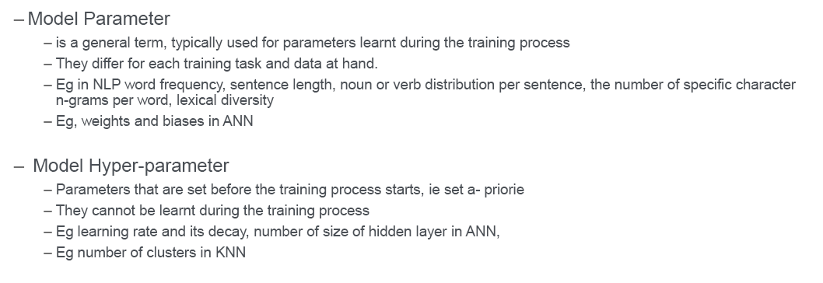
Parameter Vs. Hyper-parameter

Slide 14
TWO SUPERVISED ALGORITHMS
CLASSIFICATION | REGRESSION
SPLIT IT | FIT IT
DISCRETE / CATEGORICAL DATA | CONTINUOUS /REAL NUMBER DATA
HAS CATEGORY ASSOCIATED | HAS ASSOCIATED NUMBERS
EG. TUMOUR CLASSIFICATION | EG: PREDICTION OF STOCK MARKET

Slide 15
Mathematical concepts
LINEAR ALGEBRA
- Machine learning involves mapping
from vector to vector
matrix transformation may be required
Probability
- data and results may have un-certainity
associated with them
- Conditional probability also plays a important role
Optimization
For a given set of data what is the best model

